Slide 1
NTNU
2D-Based Device
Author: Matteo Lenzi

Slide 2
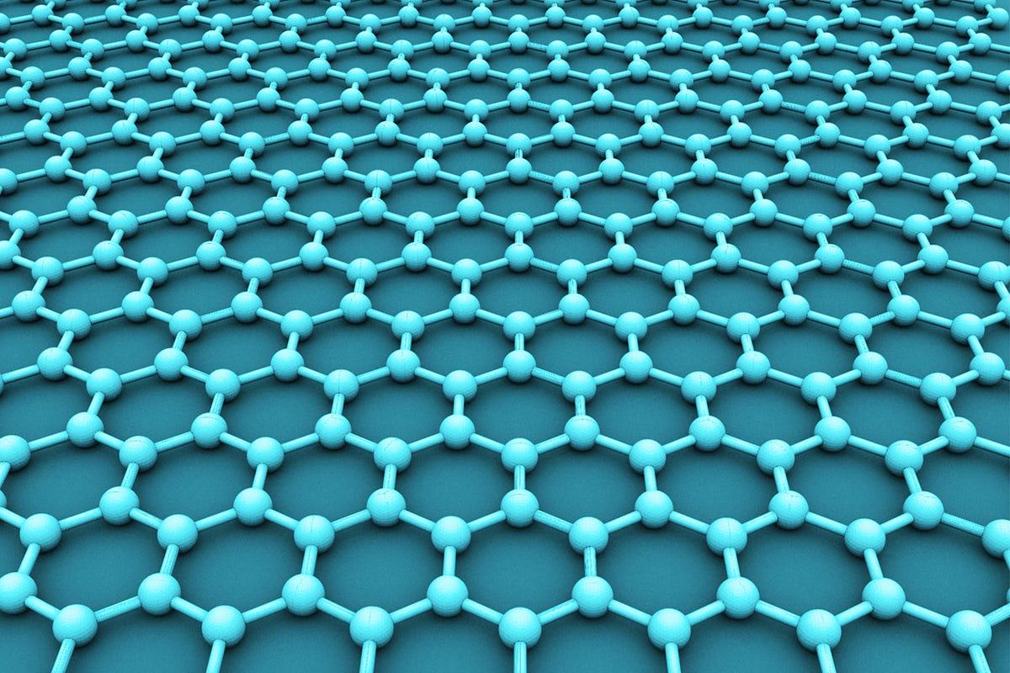
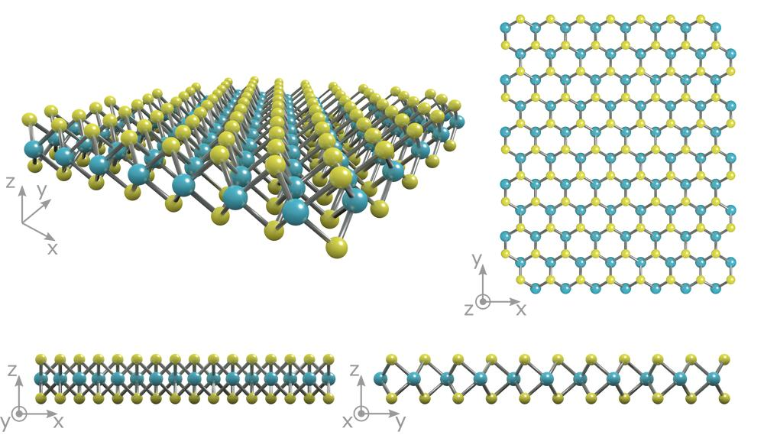
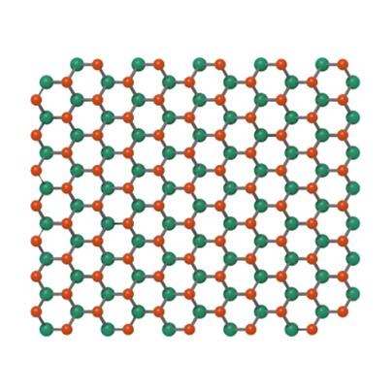
Definition of 2D material
NTNU
2D materials are crystalline materials with thicknesses ranging from a single atomic layer to a few atomic layers, which are held toghether by weak interactions as VDW forces, and with potentially different properties from the bulk material.
Graphene
MoS2
H-BN

Slide 3
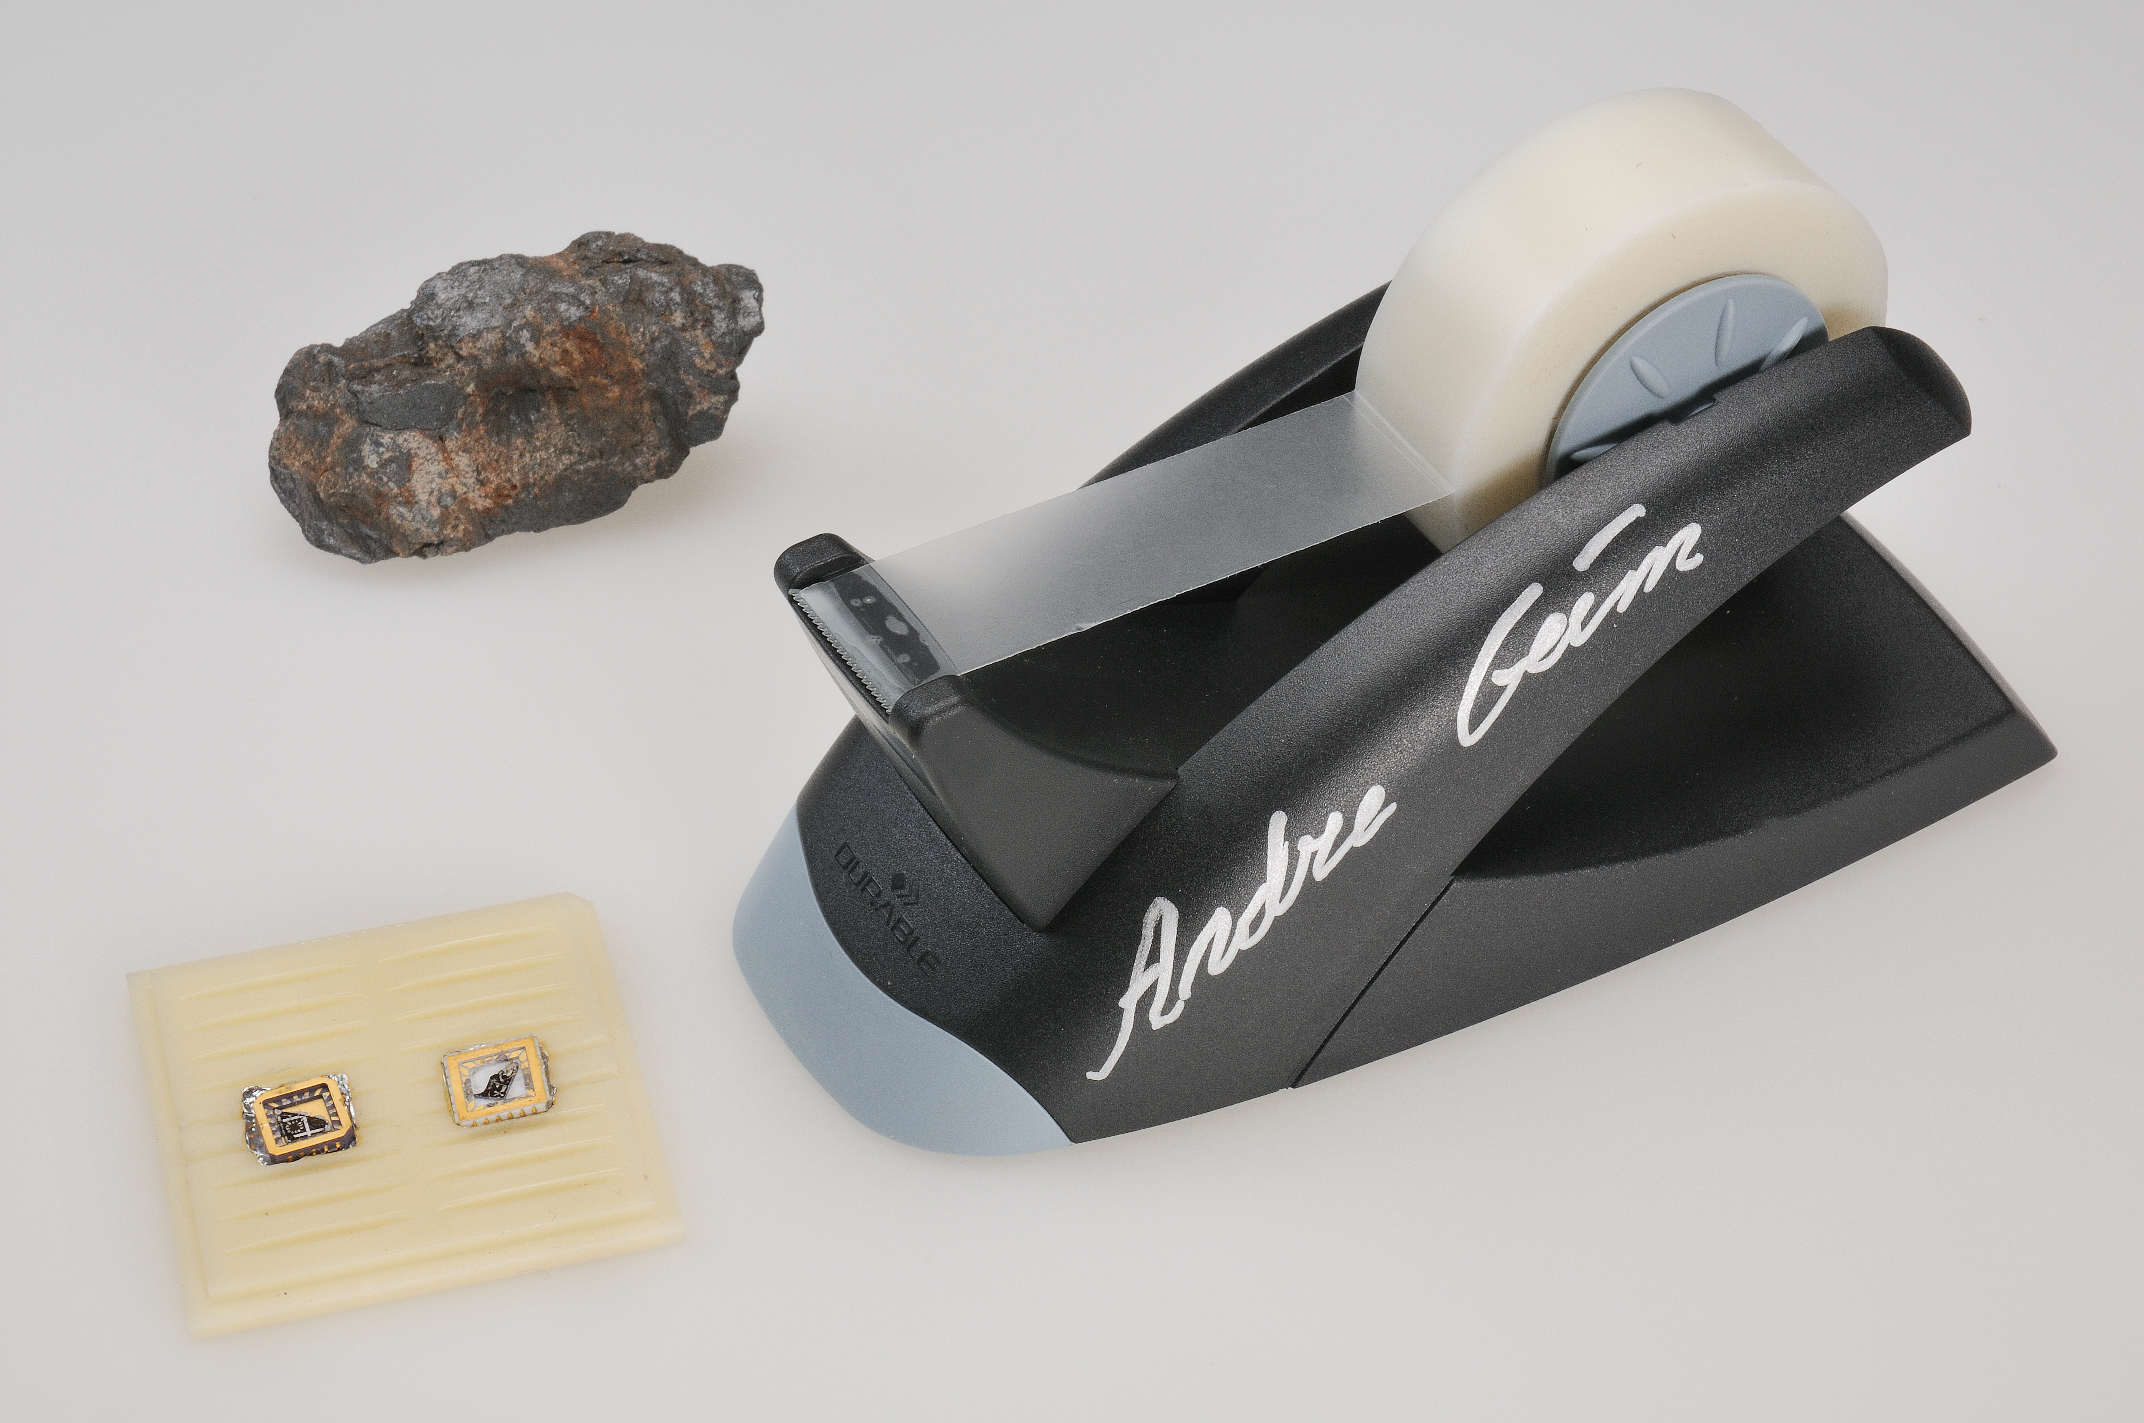
Definition of 2D-based devices
NTNU
2D based devices are sensor, electronic and optoelectronic devices built from 2D material.
A lump of graphite, a graphene transistor, and a tape dispenser signed by Andre Geim. Donated to the Nobel Museum in Stockholm by Geim and Konstantin Novoselov in 2010.

Slide 4
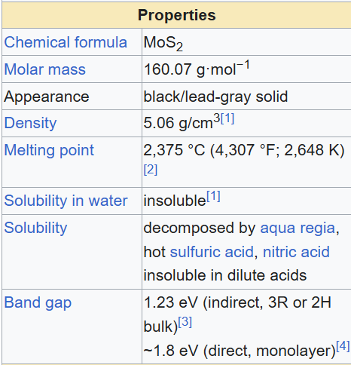
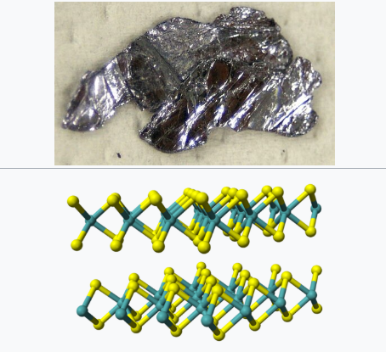
Worked out example MoS2
NTNU

Slide 5
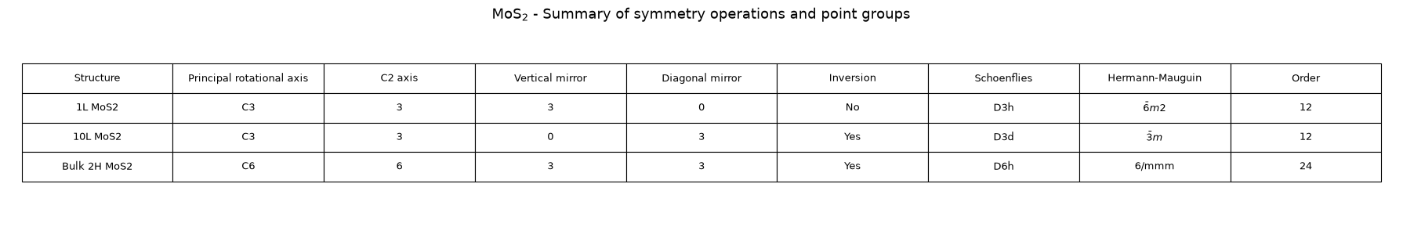
Worked out example MoS2
NTNU
These results from the python code show how the number of layers influence the point group of the monolayer compared to the bulk material. Therefore, monolayer and bulk material will have different properties.
For example, in MoS2 the monolayer may exhibit 3° rank properties (e.g. piezoelectricity, Pockel effect and Kerr effect) because it is not centrosymmetric while the multilayer and the bulk material cannot.

Slide 6
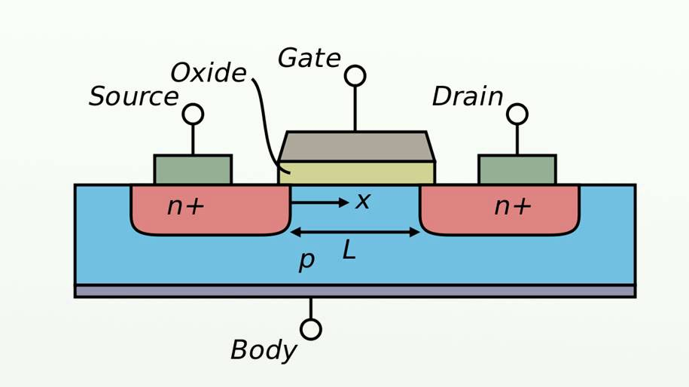
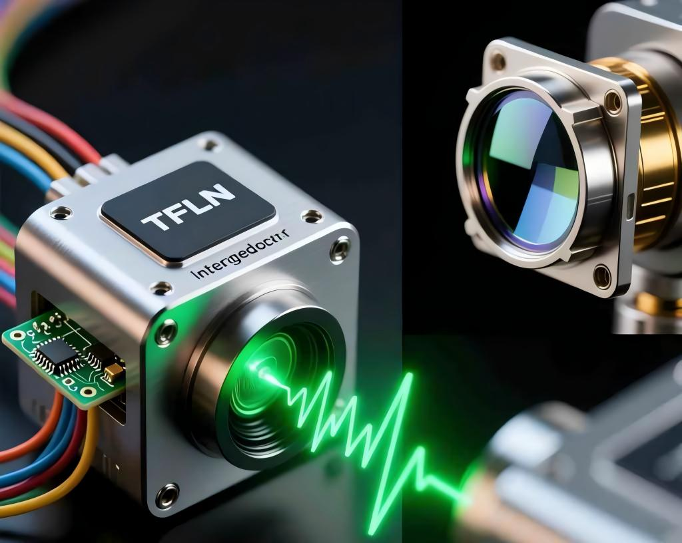
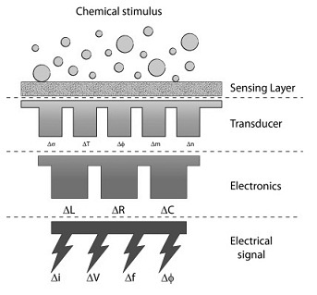
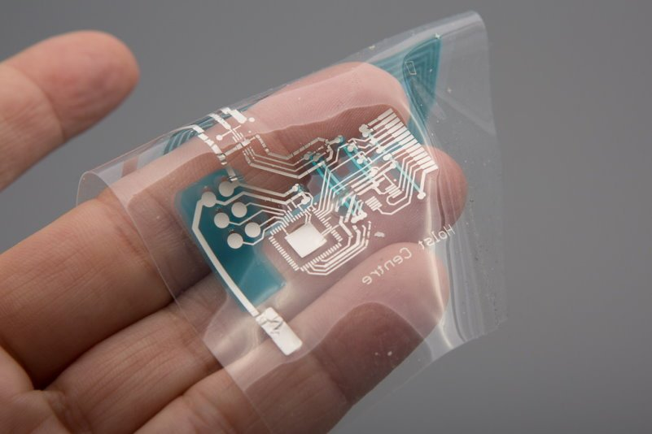
Applications
NTNU
Field-effect transistors
Photodetectors
Chemical sensors
Flexible electronics

Slide 7
Conclusions
NTNU
Advantages of 2D-Based Devices
Main Challenges to Overcome
Atomic thickness and miniaturization
Tunable electronic and optical properties
High electrostatic control
High surface sensitivity
Mechanical flexibility and heterostructures
Material quality and uniformity
Scalability of production
Environmental stability
Contact resistance and interface engineering
Reproducibility and reliability

